Slide 1
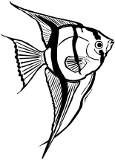
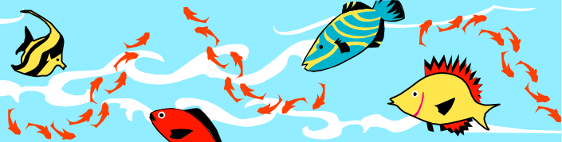


AP® Marine Biology Simulation
Case Study
Alyce Brady
Kalamazoo College

Slide 2
The Story
A CS student, Pat, gets a summer job working for marine biologists.
Hired to enhance an existing program that simulates fish movement in a bounded environment.
  Needs to understand existing program
  Designs, codes, and tests modifications
Occasionally Pat turns to an experienced programmer, Jamie, for help.
Narrative is Pat’s report of summer job.
Notes:
Jamie enhances the master/apprentice relationship aspect; provides information when Pat is confused, makes some suggestions showing great foresight, and, at the end, even offers to make needed changes to the graphical user interface.

Slide 3
The Package
Code for the “existing” program
  Source for core classes
  Jar files for “black box” & GUI classes
Javadoc documentation for most classes
Data Files
Instructions for compiling/running
Narrative (pdf file)

Slide 4
The Modules (Chapters)
Experiment with existing program (run it)
Guided tour of the code by Jamie
Add breeding and dying
Add two new kinds of fish (inheritance)
Provide alternative representations (unbounded environment, others)
Notes:
Chap 5: Alternative representations
* interfaces
* follow-up part-time job during school year
* AB only

Slide 5
First Day on the Job
Chapter 1
“[The program] was designed to help the marine biologists study fish movement in a bounded environment, such as a lake or a bay.”
Jamie not available until the next day.
Pat is given instructions for running the program and told where to find data files.
Notes:
CAN DO EARLY IN SCHOOL YEAR
How does the program appear to model the body of water (the "bounded environment")? What do the grid lines represent?
Where can fish be in the model? Can there be more than one fish in the same place at the same time?
Do all fish face the same direction? Does a fish's direction appear to matter?
Pick one fish and watch it for several steps. Does it move in every step? How far does it move? Does it always move in the same direction? Can it move in any direction? Is it more likely to move in one direction over another?

Slide 6
Exploring the MBS Files
Examine the folders from the zip file
Black Box Source Code
GUI Source
JavaMBS --- Contains Source Code
Documentation (HTML Docs)
Narrative (2002_MBS.pdf)
Open the Index.html and look around
Open the 2002_MBS.pdf and look around
Look at the data files

Slide 7


Guided Tour
Chapter 2
“The biologists think of the environment as a rectangular grid, with fish moving from cell to cell in the grid. Each cell contains zero or one fish.”
Notes:
Need to have covered
* basic flow control constructs
* basic parts of a class
* 1D arrays
There’s an optional supplement you can use earlier, if you want
* constructing objects
* invoking methods
* uses two of the simpler utility classes

Slide 8
What classes are necessary?
Chapter 2
To model fish swimming in a bounded environment, the program has Fish objects and an Environment object.
The purpose of the program is to simulate fish moving in the environment, so the program also has a Simulation object.
There are other useful, but less important "utility classes."
Notes:
Utility classes are “black-box” -- class documentation only.

Slide 9
Run the Initial MBS
Chapter 2
Run SimpleDemo1 with Fish that simply move (use OrigFishLE3.mcp)
Examine the code , notice no simulation class
Notes:
Utility classes are “black-box” -- class documentation only.

Slide 10
Run the Second MBS
Chapter 2
Run SimpleDemo2 with Fish that simply move (use OrigFishLE3.mcp)
Examine the code , notice the use of the simulation class
Notes:
Utility classes are “black-box” -- class documentation only.

Slide 11
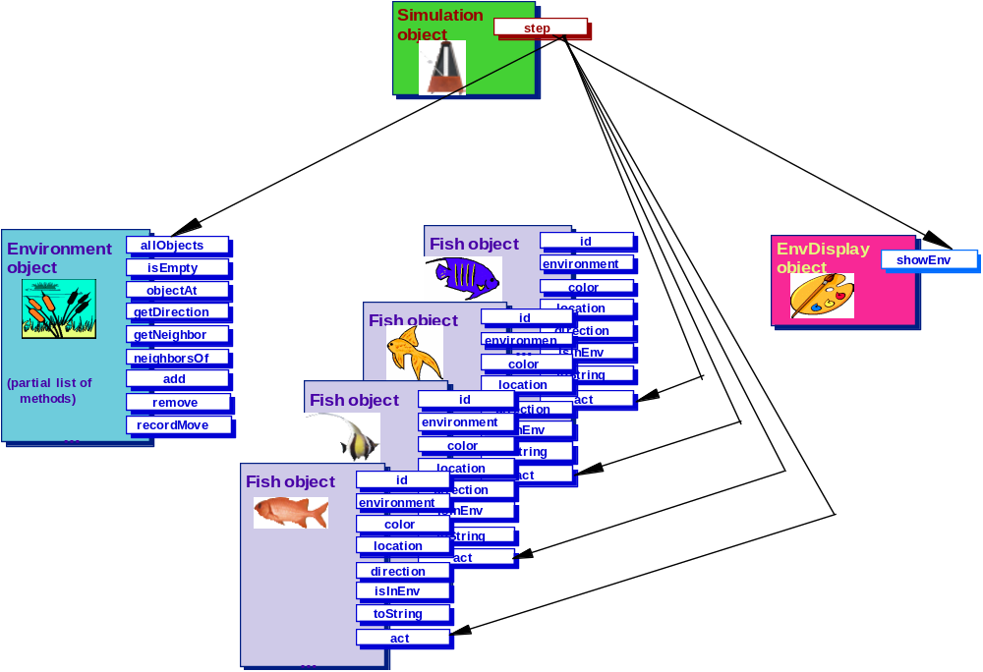
One step in the simulation
Chapter 2
Notes:
Simulation knows about the environment.
It asks the environment for a list of all the fish. (Technical detail: a Java array.)
Asks each fish to act (which, for now, just calls move).
At end of step, asks the display object to display the environment.

Slide 12
What do core classes look like?
Chapter 2
Simulation: step method - very simple loop through all the fish (see p. 21)
Environment: black box; only look at class documentation (until Chap 5)
Fish:
  has color, direction
  move method is a little more complicated, has more helper methods
Notes:
Simulation:
almost identical to C++ MBCS
has no run method
Environment: IS AN INTERFACE !
class documentation -- think header file!
some methods are very similar, some not so similar
environment of generic objects (almost), so method names are numObjects, allObjects, objectAt, etc.

Slide 13
Constructors
Chapter 2
Initialize instance variables
Add the fish to the environment
  a fish knows about its environment
  must always be in an environment to be in a consistent state
See pp. 27-28

Slide 14
move method
Chapter 2
Get next location to move to (call nextLocation)
If next location is different from this location,
  move there (call changeLocation)
  change direction (call changeDirection)
Notes:
changeLocation and changeDirection are not really necessary, but are needed later for subclasses, so we introduce them here. All they do is to modify the instance variables, but since the data is private the subclasses would not be able to do this directly.

Slide 15
nextLocation method
Chapter 2
Get list of empty neighboring locations (call emptyNeighbors)
Remove location behind fish from list
If there are any empty neighbors left, randomly choose one; otherwise return current location

Slide 16
Run the GUI Version MBS
Chapter 2
Run MBSGUI with Fish that simply move (use OrigFishLE3.mcp)
Examine the code , Black Box
Notes:
Utility classes are “black-box” -- class documentation only.

Slide 17
Breeding and Dying
Chapter 3
Problem Specification: A fish should ...
  have a 1 in 7 chance of breeding,
  breed into all empty neighboring locations,
  attempt to move when it does not breed,
  never move backwards, and
  have a 1 in 5 chance of dying after it has bred or moved.
Notes:
Short chapter -- point is just to make some modifications to the code before going further. Could do this chapter AFTER the next one on inheritance (or not at all); if done after inheritance, could have students implement this as an extension (subclass) of Fish rather than as modifications to Fish.

Slide 18
Breeding and Dying
Chapter 3
Pseudo-code for act method
if this is the 1 in 7 chance of breeding
call the breed method
else
call the move method
if this is the 1 in 5 chance of dying
call the die method

Slide 19
Lets look at the Fish Class Modifications for Breeding & Dying
Chapter 3
Examine the modified fish class that includes breeding and dying
Marine Biology Case Simulation\JavaMBS\Code\
DynamicPopulation\fish.java

Slide 20
Specialized Fish
Chapter 4
Different patterns of movement
  Darters (DarterFish)
  Slow fish (SlowFish)
Inheritance
Dynamic Binding

Slide 21
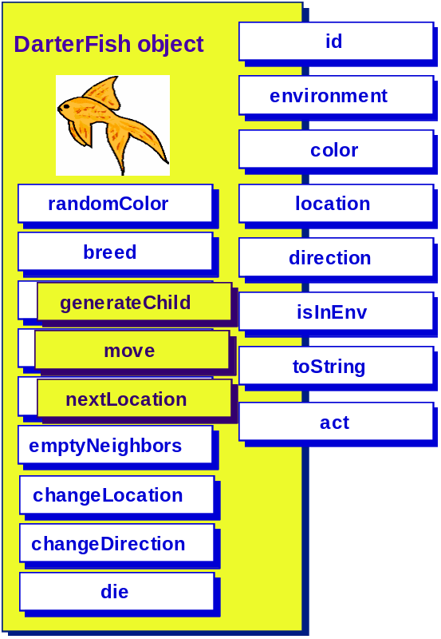
Specialized Fish
Chapter 4
DarterFish
  darts two cells forward if possible
  or darts one cell forward
  or reverses direction (without moving)

Slide 22
Specialized Fish
Chapter 4
SlowFish
  has only a 1 in 5 chance of moving out of current cell
  otherwise movement is the same as Fish
Notes:
I provided the pages about SlowFish in the handout (pp. 72 - 75).

Slide 23
Run the Dynamic Fish Version
Marine Biology Case Simulation\JavaMBS\Code\DynPopLE3
Note darter and slow fish
Create and SAVE New Environments

Slide 24
Environment Implementations
Chapter 5
Multiple environment implementations
  Environment Interface
  Bounded: 2D array (matrix) -- existing
  Unbounded: ArrayList of Fish -- Pat develops this implementation
Notes:
Only Chapters 1 - 4 are required for A course.
Chapter 5 deals with traversal of 2D array (could be CS 1 or CS 2);
overall topic is “alternative data representations”
has some discussion of efficiency, algorithm analysis
exercises ask students to implement environments using
Spare matrix
Hash map
etc

Slide 25
“AB” Exam Summary
Class Implementations
  Simulation (Chap 2)
  Fish (Chaps 2 & 3)
  DarterFish (Chap 4)
  SlowFish (Chap 4)
Additional Class Interfaces/Implementations
  Environment
  BoundedEnv
  UnboundedEnv
Class Documentation
  One new utility class
Notes:
New Utility Class
SquareEnvironment

Slide 26
MBS Debugger
debug.turnOn( )
debug.turnOff( )
Demonstrate the Debugger
Notes:
New Utility Class
SquareEnvironment

Slide 27
MBS Role Playing
Get to better understand the Case Study by “Role Playing” a Simulation Step
Notes:
New Utility Class
SquareEnvironment

